Slide 1
GET INVOLVED: mMTC’s “BRING YOUR ENGINEER TO SCHOOL DAY” Program
Instructions to get involved and prepare your materials
Notes:
The following slides provide an overview of our new “Bring Your Engineer to School Day” program. They provide instructions for engineers/industry professionals on how to get involved, get partnered with an educator and facilitate the classroom discussion and interactive activity. The classroom presentation template begins on slide 12 – be sure to review the instructions on slides 4-11 before downloading, tailoring and presenting the PowerPoint in a classroom.
Please delete this slide and all other instructional slides before presenting.

Slide 2
About the MMTC
The Michigan Mobility Talent Consortium (MMTC) is cultivating and expanding the talent pipeline for mobility careers in Michigan. MMTC was established in 2019 in Detroit, Michigan, to create a comprehensive solution to develop, attract and retain the top-talent needed for a successful future.
MMTC’s vision is to increase and develop the qualified talent pool in the automotive / mobility industry. To achieve our vision, MMTC is building bridges between industry, educational organizations and government institutions.
Learn more about the MMTC’s vision and goals at michauto.org/michigan-mobility-talent-consortium/.
Member organizations
MMTC consists of industry, governmental and education partners, including:
Autoliv
Bosch
Cooper Standard
Dana
Lear
Magna
MICHauto
Stellantis
Visteon
Webasto
Notes:
Please delete this slide before presenting.

Slide 3
About the MMTC (cont.)
The MMTC’s current leadership includes several key industry partners, including:
Michelle Acciavatti Managing Director, Midwest Region Leader WTW
Charlie Ackerman Senior Vice President Human Resources Bosch LLC
Larry Ott Senior Vice President and Chief Human Resources Officer Cooper Standard
Kristin Trecker Chief People Officer Visteon Corporation
John Jones North America Geographic Leader, Employee Experience WTW
Notes:
Please delete this slide before presenting.

Slide 4
“Bring Your Engineer to School Day” Program
In partnership with MICHauto and the State of Michigan’s Mobility Futures Initiative, MMTC is proud to provide a new program designed to:
Expand the knowledge of local teachers about career opportunities and the unique and exciting skills needed in the mobility industry while debunking myths about the opportunities and traditional perceptions
Build lasting relationships between classrooms and industry
Increase the number of students interested in the industry and generate excitement about the future of mobility
Ultimately, retain talent in Michigan by employing more students in well-paying, dynamic Michigan jobs
Through our “Bring Your Engineer to School Day” program, engineers and other mobility industry professionals will have the opportunity to give local students a glimpse into what it really means to be an engineer by visiting a classroom, facilitating an interactive activity and sharing a few real-life examples.
At this time, the program is being offered to high-school classrooms in the following districts: Detroit Public Schools, Lansing Eton RESA and Wayne-Westland. We hope to expand the program in the near future.
Time commitment and expectations and engineers and industry professionals
Since our volunteers are all working engineers, we are only asking participants to commit to one classroom session – typically 50-60 minutes – with 1-2 hours of preparation time. There is no expectation to continue a relationship with the classroom or visit multiple times, though you are welcome to if you so choose. You may also volunteer to facilitate sessions with other classrooms, but it is not required.
The most important commitment is to bring your passion and energy for engineering! Your enthusiasm for your work and willingness to share your story is what will make this program a success.
Notes:
Please delete this slide before presenting.

Slide 5
How to participate as an engineer/ Industry professional
Everything you’ll need to participate in this program is outlined in this deck. Click through the following slides to learn more and get started.
The information in this deck is primarily for engineers and other industry professionals that want to volunteer in a classroom. If you are a teacher or school representative interested in hosting an engineer, please refer to the contact information listed on michauto.org/michigan-mobility-talent-consortium/.
Step 1: Get partnered with a classroom
Please send an email to the contact listed on michauto.org/michigan-mobility-talent-consortium/ with the following information:
Your name
Your title and company
Your general availability (e.g., next month, next quarter, flexible)
You’ll receive an email back with more information and next steps.
Notes:
Please delete this slide before presenting.

Slide 6
Step 2: Coordinate with your educator partner
Use the contact info provided by MMTC to contact your educator partner. Work with your assigned educator to:
Select a date and time
Confirm directions, classroom location, security requirements, presentation setup (including any technology requirements), other day-of logistics, etc.
Get to know the classroom and students (e.g., what’s the class subject, what STEM or technical knowledge do students have, if any, what best engages students)
Ask your educator partner to let the students know about your visit and background and help with preparing for the activity by:
Forming roughly 3-5 teams of 4-8 students depending on the size of the classroom (fewer groups means the student presentations will take less time but can limit student participation; ask your educator for guidance)
Setting up tables/activity spaces for each group
Notes:
Please delete this slide before presenting.

Slide 7
Step 3: prepare your materials
Order/access the Lego set: When you sign up, you will receive instructions on how to order or access a set of Legos for use in the classroom.
Save a copy of the classroom discussion PowerPoint template and tailor it
The classroom PowerPoint template can be found within this PowerPoint deck (following these instruction slides and beginning on slide 12)
Save the PowerPoint template to your files so you can make updates and delete all the instruction slides
Check out the instructions on the slide and in the speaker notes for guidance on how to update the deck
Most of the PowerPoint is ready for use, including the interactive activity—you’ll only need to update your personal bio slide and the real-life example slides (directions to update these can be found in the template)
See the “Tips and best practices” section
Delete any instruction or example slides
Email a copy of the final PowerPoint deck to your assigned educator at least one week in advance for any feedback
Notes:
Please delete this slide before presenting.

Slide 8
Step 4: learn how to facilitate the discussion and activity
While leading the classroom discussion, you’ll want to use the PowerPoint presentation as a guide for the conversation while bringing the information to life through storytelling. You’ll use your personalized PowerPoint deck and:
Introduce yourself: Share your name, title and the work you are involved in at your company. Explain to the students why you are passionate about engineering and what sparked your interest in the field. Use some of the images on your slide to tell them about yourself – like hobbies, interests and education. When explaining your role, use common language and describe your day-to-day as well as the impact of your work.
Run the activity: Explain the activity and ask your educator to divide students into pre-selected groups. Provide the Legos and use the slides to walk through the activity. Walk around during the activity and check in with the groups to see how they are doing and answer questions. If any groups are having trouble, consider giving them some ideas to get started.
Share a real example: When describing your own real-life example, use storytelling to highlight a problem or challenge and how you overcame it using creative problem solving. Avoid any jargon and technical speak when explaining the activity.
Leave time for questions: Remember to leave time for discussion and questions at the end.
Gather feedback: Partner with your educator partner to gather informal feedback directly from the students. To ensure the students are comfortable, this should happen after you have left the classroom.
Notes:
Please delete this slide before presenting.

Slide 9
Step 5: review tips and best practices
Before presenting in the classroom, here are a few tips and best practices to consider:
Know your audience and speak in plain language: Connect with the educators beforehand to learn more about the students. Gather more information about the grade levels or get an understanding of their exposure to STEM. Limit the jargon and technical speak.
Set the tone: Bring a lot of energy to the classroom to get the students excited and ready to engage in the activities. Talk about your work in a fun way for students to relate. For example, “The car would catch on fire!” or “We saved a million dollars!” or “Our team produced 100,000 cars!” are the taglines students love to hear. Highlight the many exciting Engineering career paths needed in Mobility: Mechanical, Electrical, Manufacturing, Packaging, Quality, Management, Computers, Robotics, etc.
Get interactive: Dive into the activity as soon as possible to keep the students interested in the discussion. Walk around and interact with groups as they work on the activity.
Make it relatable: Tell a story that is not just a good example of engineering — tell one that personally resonates with you as a career accomplishment. Honest excitement resonates.
Storytelling: Storytelling is a powerful way to get your message across. Rather than focus on the technical aspects of your job or real-life example, focus on what you were trying to solve, how you went about it and the impact.
Make it a discussion not a presentation: Students know the difference between being talked at and talking with. Make it clear at the start that if a student has something they want to ask, they are welcome to ask it right then and do not need to wait until the end of the session.
Notes:
Please delete this slide before presenting.

Slide 10
Step 5: review tips and best practices (cont.)
Focus on the basics: Students have never worked in an industry job, so you’ll need to help them to understand the very literal daily activities of working in the industry like meetings, working hours, tools and resources, and other topics that we don’t even think about but perform on a daily basis. Help students understand that your job includes both computer and on-hands work.
Leave time for Q&A: Leave plenty of time for students to ask any questions. If the students do not have any questions, prepare some questions for the students or additional stories/examples.
Share the right resources: Leave your personal contact information with your educator partner rather than directly with students. Instead, point them in the direction of useful resources if they are interested in STEM or learning more.
Step 6: stay involved
We value your participation in this program with MMTC. It is key to demonstrate to students how they can make a difference and get involved in STEM. If you would like to continue partnering with your educator partner to schedule classroom visits (including to present on future STEM skills), feel free to stay in touch. You can also contact the MMTC via the email address listed on michauto.org/michigan-mobility-talent-consortium/ to be connected with additional educators and classrooms.
We also welcome any referrals you may have!
Notes:
Please delete this slide before presenting.

Slide 11
How to use the classroom template
Use this deck as a template when presenting in the classroom as part of the Michigan Mobility Talent Consortium’s “Bring Your Engineer to School Day” program. It is designed to be customized based on your experience.
There are several slide layouts available for personalization.
Please use presentation mode so that you’re able to see the speaker notes during your presentation.
Full instructions, tips and resources can be found at [URL].
Notes:
HOW TO USE THIS DECK
Please delete this slide before presenting.
In pre-designed slides, each chunk of information has been animated. In the notes, “CLICK” denotes the moments when you should click to reveal the next chunk of information.
Note that image placeholders are included throughout the presentation. For the best learner experience, choose imagery that aids in learners’ understanding of the text and is not pixelated.
Recommend using unsplash.com or stock.adobe.com (selecting “Free” from dropdown menu) to find free, high-quality images for this (and any) presentation.

Slide 12
Welcome to… “BRING YOUR ENGINEER TO SCHOOL DAY”
Notes:
BRING YOUR ENGINEER TO SCHOOL DAY
Use this slide to welcome students as they walk into the classroom.
The subtitle is optional, but might include the presenter’s name, title, and company.
Sample introduction:
“Good morning! My name is [INSERT NAME], and I work at [COMPANY NAME] as a [ROLE AT COMPANY]. Today, we’re going to [BRIEF DESCRIPTION OF ACTIVITY].

Slide 13
Today’s activities
A little bit about me (and the mobility industry)
Putting your skills into action (activity time!)
Real-life examples
Day in the life of an engineer
Next steps
Notes:
AGENDA
This slide should give an overview of how time will be spent in the session.
Sample agenda items are provided but should be customized based on the individual presentation.
Sample script:
“Here’s how we’ll spend our time together today. First, we’ll [FIRST AGENDA ITEM]. Next, we’ll [SECOND AGENDA ITEM]…”

Slide 14
Welcome
Notes:
WELCOME
Use this slide to provide a more in depth of introduction of yourself. This could include your tenure with your organization, where you went to school, major projects you’ve worked on related to the presentation, and a personal fact and/or hobbies. Think about what might be most relatable to students and try to use photos rather than a lot of words. Space is provided to include relevant imagery.

Slide 15
Mobility industry: What it’s all about
What it’s all about:
The mobility industry deals with anything that transports people and/or goods
Mobility in the world today:
Gas cars
Diesel Cars
Electric Cars
Who works in mobility:
Engineers
Software designers
Mechanics
Sales associates
Account Managers
Corporate communicators
The future of mobility:
Transportation through apps (including e-bikes and scooters)
Autonomous Vehicle (AV) technology
Notes:
MOBILE INDUSTRY: WHAT IT’S ALL ABOUT
This slide provides information about the mobility industry in a way that is easy for the learner to understand. As to not overwhelm the learner, read the text in each box before clicking and revealing the next box.
What it’s all about:
CLICK
Mobility in the world today:
CLICK
Who works in Mobility:
CLICK
The future of Mobility:

Slide 16
Put your skills into action
Notes:
PUT YOUR SKILLS INTO ACTION (SECTION TITLE SLIDE)
The next two slides provide the context for the interactive activity. See below for instructions:
How to set up the classroom:
It is advised that the teacher find a way to split the students before you arrive. If possible, students should be arranged in groups of three to five students with a maximum of five groups.
The goal is to have at least three students in each group (one for each role on Slide 8) but to limit the number of groups so every group can present in the time allotted.
Make sure each group has a large workspace (a table or several desks pushed together) to collaborate. You may want to ask the teacher how they personally handle collaboration in the classroom.
Once students are settled in their groups, go through the scenario and instructions on the slide above.
Distribute the Lego sets evenly amongst the groups. Keep it random; the more varied the parts the more interesting their results.
Before beginning the activity, share the content on the next slide.

Slide 17
Setting the stage
The Company: Sky High Incorporated, a transportation manufacturer
The Problem: You have finished production on several products and realize you have spare parts left over
The Ask: Use the spare parts to design a transportation device that can take people at least one mile and helps save money and eliminate waste
The Catch: You can only use the spare parts left over from production!
Watch the clock!
20 minutes to construct your transportation device
2 minutes to present your device to the class
1 minute to answer questions after your presentation
Notes:
SETTING THE STAGE
Introduce the activity. Read each bulleted item, then click to reveal the next bullet to avoid overwhelming the learner.
The Company
CLICK
The Problem:
CLICK
The Ask:
CLICK
The Catch
CLICK
Watch the clock!

Slide 18
Ready, set, engineer!
Your teacher has split you into groups. Each group should decide on roles:
Consider:
What powers your device?
Who will be the target customers/market?
How will you ensure the safety of your passengers?
How is your device piloted?
What makes your device unique and interesting?
Tip: be prepared to answer these during your presentation
Project managers
Builders
Brainstorm types of devices
Keep the team on track
Watch the time
Assist builders and presenters
Create device using creative problem solving
Construct components
Presenters
Present the idea
Answer questions after presentation
Notes:
READY, SET, ENGINEER
Introduce the roles on the slide above, clicking to reveal each role and their considerations.
During the activity, walk among the students with the teacher and offer help:
Encourage students to have a time-keeper, designers, and presenters.
Answer any questions they may have about the activity, guiding them toward finding the answers themselves when possible.
Offer guidance on design considerations (e.g., “Where would a person(s) sit in that vehicle?” or “How will it get power?” or “Who would use your vehicle?”).
After the activity, ask each group to share a two-minute presentation, answering the questions listed under “Consider.”
Note:
Be mindful of the time. Classes are short, and you want to have time to debrief the activity and connect it to your personal story.

Slide 19
STUDENT PRESENTATIONS
Notes:
STUDENT PRESENTATIONS
Display this slide while students give their presentations.

Slide 20
Making it real
Notes:
MAKING IT REAL (SECTION TITLE SLIDE)

Slide 21
ENGINEERING AS PROBLEM-SOLVING
Notes:
ENGINEERING AS PROBLEM-SOLVING
Over the next 2-3 slides, we recommend providing a real-life example of creative problem-solving in engineering. The ideal example will be something that you can speak to with passion and energy, ideally from our own career or company
On this slide:
Describe the problem/challenge in everyday language; avoid jargon and overly-technical terminology
Use graphics and images to engage students while you tell the story (rather than having them read it on the slide)

Slide 22
Understanding the impact
Notes:
UNDERSTANDING THE IMPACT
On this slide:
Describe the impact of your solution from a business perspective and – if possible – from a human perspective.
Use graphics and images if possible; remember to use storytelling to bring the example to life in tangible terms

Slide 23
A week in the life of an engineer
Notes:
A WEEK IN THE LIFE OF AN ENGINEER (TITLE SLIDE)

Slide 24
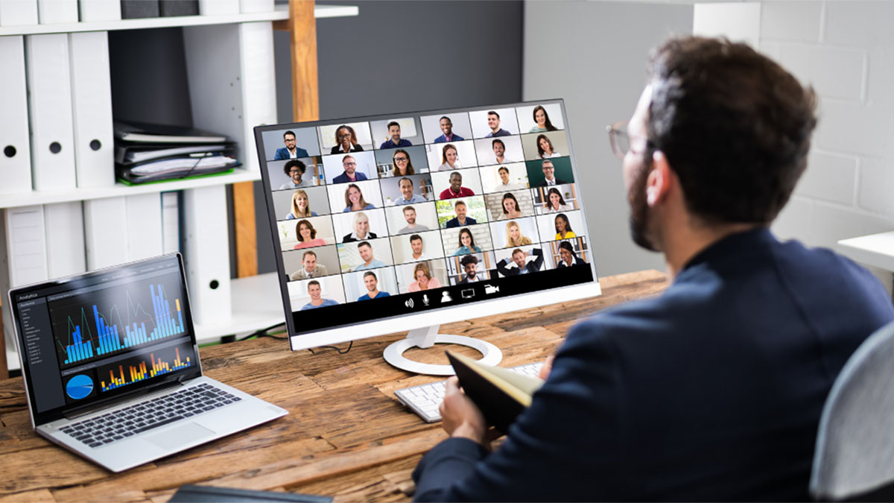
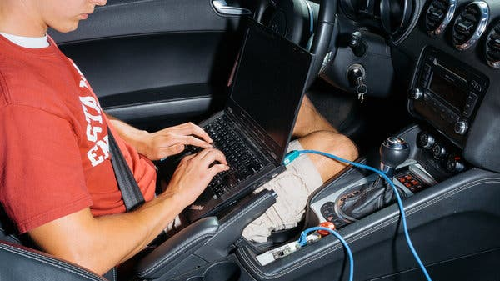
TYPICAL ACTIVITIES
Planning: Collaborate with fellow engineers
Working: Design, code, and brainstorm solutions
Presenting: Pitch your best ideas
Notes:
TYPICAL ACTIVITIES
Use this slide to give a glimpse of what an average week of an engineer might consist of, using personal examples when appropriate.
Click to reveal each item.

Slide 25
How we work
Flexibly: Switch up your schedule to what works best for you — as long as you’re focused on achieving results!
Collaboratively: Work with friendly colleagues in a competitive yet collaborative environment. Together, our work makes a difference!
Digital Tools: Use laptops, sensors, prototype vehicles, coding programs (Python), Excel, and more to design new solutions!
The best part?
No day is the same!
Work-Oriented: The days of suits and ties are gone; we now are focused on what you need to get through work comfortably!
Notes:
HOW WE WORK
This slide provides more insight into the benefits of a career in engineering. Again, add personal details as you see fit.
Click to reveal each item.

Slide 26
Questions?
Notes:
QUESTIONS?
Encourage students to ask questions about the activity and/or a career in engineering.
Examples:
What questions do you have about the activity we just did?
What questions do you have about being an engineer?
What questions do you have about the mobility industry?
What questions do you have about getting started in the mobility industry?

Slide 27
NEXT STEPS
Join a group
Ask questions
Set goals
Joining a group can help develop your skills. Try out:
First Robotics
STEAM Classes
Don’t hesitate to reach out to learn more.
Contact:
Teachers
Parents
Local STEAM/STEM programs
Set goals to help you stay on track. Try to:
Study hard to get good grades
Look for scholarship and internship opportunities
Be creative
Notes:
NEXT STEPS
Highlight ways students can start toward a career in engineering today.
Click to reveal each item.

Slide 28
Thank you!

